Slide 1
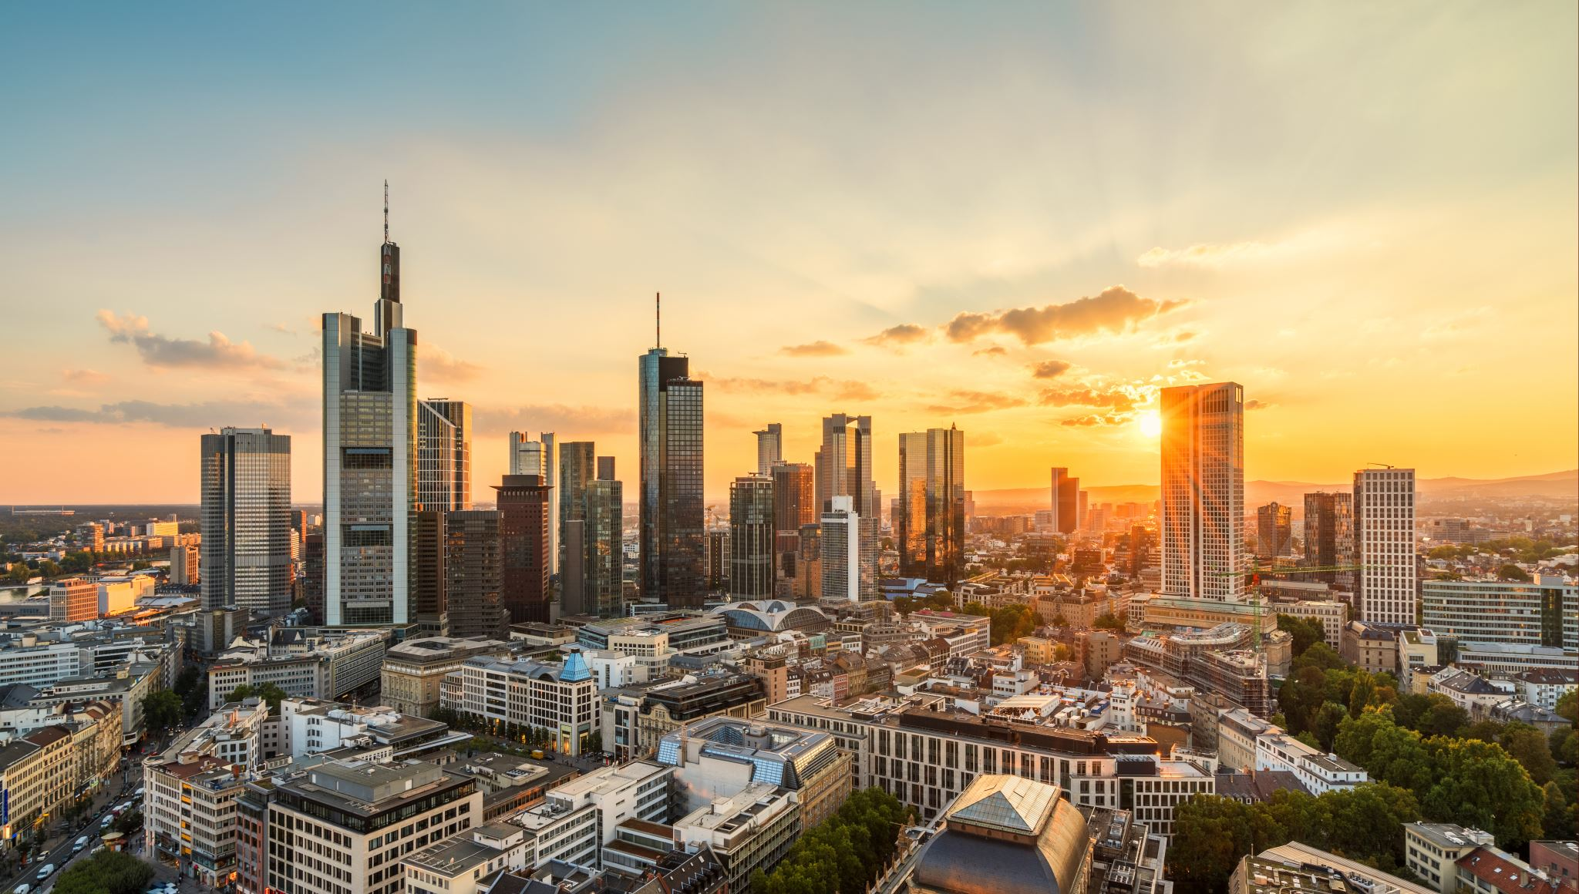
InsurTex
IST 718
Alison Reikher, Natalia Uruska, Marley Akonnor, Alexander Klein, Winston Vu

Slide 2


Who we are:
We are a property insurance company, InsurTex.
We provide the largest insurance coverage system for the state of Texas and insure millions of residents within 7 of Texas’ metro areas: El Paso, Amarillo, Dallas, Houston, Austin, Brownsville and Laredo.

Slide 3
Specifications:
Problem: Our mission is to determine the best insurance premium costs for us as a business while ensuring affordability for our loyal customers. We are attempting to predict future weather trends and their impact on insurance premium costs over the next 5 years
Hypothesis: As the climate continually changes and weather patterns become increasingly unpredictable, we anticipate that premiums will rise marginally until the underlying infrastructure issues in Texas can and have been addressed

Slide 4


Data:
1) 2020 Insurance Council of Texas Property & Casualty Insurance Market Report
2) Assessment of Historic and Future Trends of Extreme Weather In Texas, 1900-2036
3) Corporate and Insurance Data 2008-2021
4) Monthly and Annual Totals – Precipitation Data for Texas
El Paso Data + totals
Amarillo Totals
Dallas
Houston
Brownsville
Laredo
5) FEMA National Risk Index
6) State Insurance Regulation: Key Facts and Market Trends
7) Insurance Information Institute
Direct Premiums Written
Domestic Insurance Companies
Property Casualty Insurance
8) Energy Star – Texas Weather

Slide 5
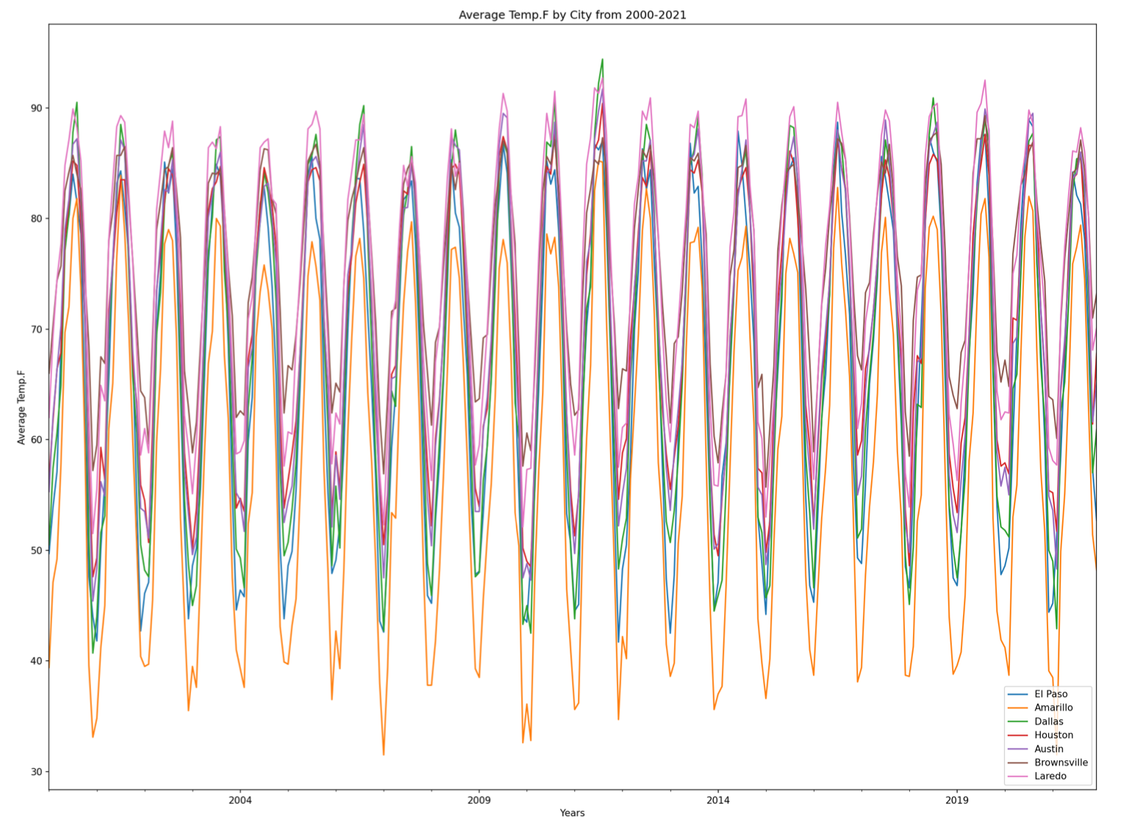
Observations:
The plot displays average temperature by city from the year 2000 to 2021.
Dallas had the highest average temperature over the 21-year time horizon with a spike to ~92 degrees in 2012.
Loredo has consistently been the hottest of the 7 cities.
Amarillo has consistently had the lowest average temperatures dropping to temperatures as frigid as ~30 degrees in 2007 and 2021.

Slide 6

Analysis:
The data being used in this project to forecast the weather is time series data with multiple variables. The model best suited for this type of data is the SARIMAX model. The SARIMAX model works well with time series data that contains trends and seasonal components while allowing for exogenous variables. We will use the SARIMAX model with the data we collected to forecast the future weather in all seven cities we provide insurance coverage to.
The insurance premium data is univariate time series data. Facebook’s Prophet model can be used to easily forecast future insurance premiums. That forecast can be used as a basis for our future insurance premiums. The future weather forecast combined with the extreme weather risk data will be used to adjust the future insurance premiums to the degree that is financially sustainable.
The sklearn RandomForestRegressor function is used to train the random forest regression model. This function utilizes ensemble learning by using multiple models trained over the same data and averages the results of each model to obtain a more capable classification result. We use this model to predict the weather forecasts of the different cities.

Slide 7
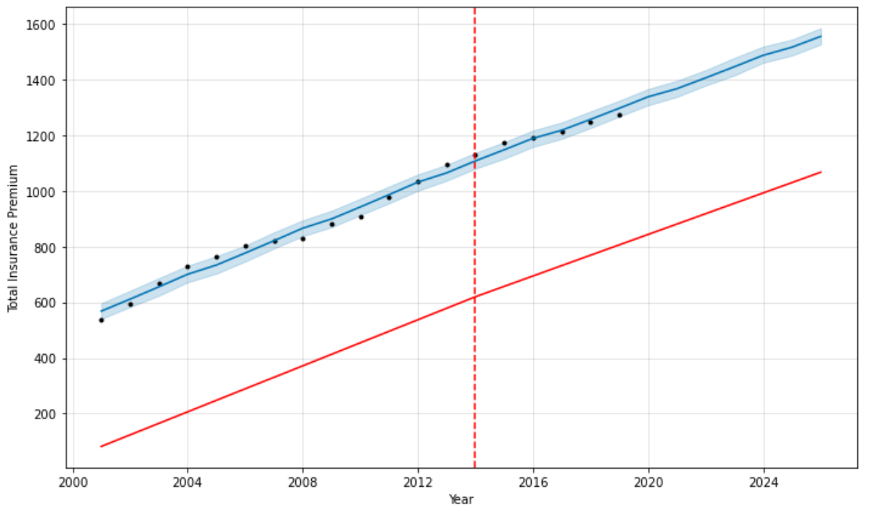
Recommendation:
Increase premiums year over year for at least the next 5 fiscal years
Weather patterns are unpredictable, especially at the extremes
Increasing premiums protect our margins while keeping prices affordable for our customers
Fiscal Year | Premium Price
2022-2023 | $1,406.10
2023-2024 | $1,446.09
2024-2025 | $1,487.14
2025-2026 | $1,516.30
2026-2027 | $1,555.24

Slide 8

References:
1) Diaz, J. (2022, January 4). Texas officials put the final death toll from last year’s winter storm at 246. NPR.Org. Retrieved August 24, 2022, from https://www.npr.org/2022/01/03/1069974416/texas-winter-storm-final-death-toll
2) Doss-Gollin, J. (2021, April 16). How Unprecedented Was the February 2021 Texas Cold Snap? State of the Planet. Retrieved August 24, 2022, from https://news.climate.columbia.edu/2021/03/16/unprecedented-texas-cold-snap/
3) National Weather Service. (n.d.). Hurricane Katrina - August 2005. Weather.Gov. Retrieved August 24, 2022, from https://www.weather.gov/mob/katrina

Slide 9

Questions?

